Slide 1

01
AI-POWERED CHAT SYSTEMS USING GROQ API
Presentation By:
Fathimath Riya Afreen M A
Reflections Info Systems Pvt Ltd.

Slide 2
02
PROJECT OVERVIEW
02
Project 1: AI Chatbot using Groq API
Built a conversational AI chatbot using Groq LLMs
Supports real-time, multi-turn interactions with users.
Project 2: RAG AI Chatbot
Built a RAG chatbot for PDF-based question answering
Retrieves relevant information from uploaded documents before generating responses.

Slide 3

03
TASK 1 :
AI CHATBOT
Developed an AI-powered chatbot using the Groq API that interacts with users in real time and generates intelligent responses.
Functions :
Enables real-time conversations between users and AI.
Generates intelligent responses to user queries.
Supports customizable communication styles .

Slide 4
04
UNDERSTAND THE TERMS
Semantic Search → Searches based on meaning, not just keywords
Embeddings → Converts text into a format the AI can understand and compare
Vector Database (ChromaDB) → Stores document information for quick searching
RAG → A system that searches documents before generating answers

Slide 5
05
BUSINESS PURPOSE
Enhance user engagement through AI assistance.
Reduce manual effort in customer interactions.
Improve response speed and availability.
Automate responses to common user queries.

Slide 6
06
KEY FEATURES
Real-time AI-generated responses
Multi-turn conversation memory
Customizable chatbot behaviour
Adjustable response creativity

Slide 7
CONTRIBUTIONS
07
Set up project environment and dependencies
Integrated Groq API with Python application
Developed chatbot conversation logic
Implemented message history management
Tested different LLM models and parameters

Slide 8
08
CHALLENGES & SOLUTIONS
Issue with deprecated model ; solved by replacing it with llama-3.1-8b-instant
Response behaviour was inconsistent initially; improved it using prompt engineering and system prompts
21% Increase in Stock Prediction Accuracy

Slide 9
TASK 2 :
RAG AI CHATBOT
09
Built an AI assistant that can answer questions from uploaded PDF documents.
The system identifies the most relevant information from the uploaded documents and uses AI to generate accurate answers.
Implemented using a RAG (Retrieval-Augmented Generation) approach, where document content is retrieved first and then used by the AI to create responses.

Slide 10
BUSINESS PURPOSE & FEATURES
10
Business Purpose
Reduce the time required to search through large documents.
Provide quick and accurate answers from uploaded PDFs.
Improve access to information and knowledge within documents.
Enhance productivity by minimizing manual document review.
Key Features
single or multiple PDF documents are supported.
Semantic search.
Context-aware AI-generated responses.
Chat history for maintaining conversation flow.
Source chunk display .
User-friendly Streamlit interface.

Slide 11
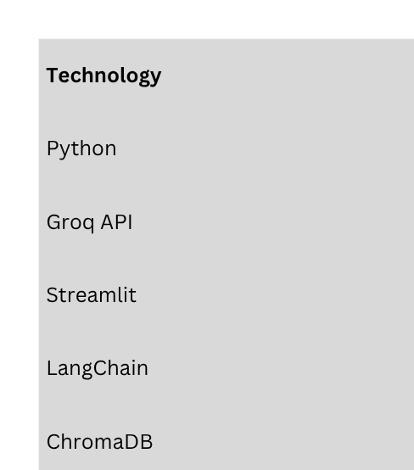
11
Technologies used :

Slide 12
12
CONTRIBUTIONS
Developed the RAG pipeline
Implemented PDF processing and document retrieval.
Integrated Groq API for AI-generated responses.
Built the Streamlit user interface.
Added chat history and source reference features.
Optimized retrieval and answer accuracy.
Implemented persistent ChromaDB storage

Slide 13
13
CHALLENGES & SOLUTIONS
Implemented persistent ChromaDB storage to retain document data across sessions.
Fixed issues with newly uploaded PDFs not being indexed correctly.
Reduced inaccurate responses by improving retrieval and prompt design.

Slide 14
PROJECT OUTCOME
Successfully built and tested a Retrieval-Augmented Generation (RAG) AI system.
Implemented document-based question answering using PDF content instead of relying solely on LLM knowledge.
Integrated semantic search, embeddings, and ChromaDB for efficient information retrieval.
Added advanced features including multiple PDF support, chat history memory, source chunk display, and persistent database storage.
Evaluated and improved system performance by experimenting with chunk size, retrieval settings, and prompt design.
14

Slide 15
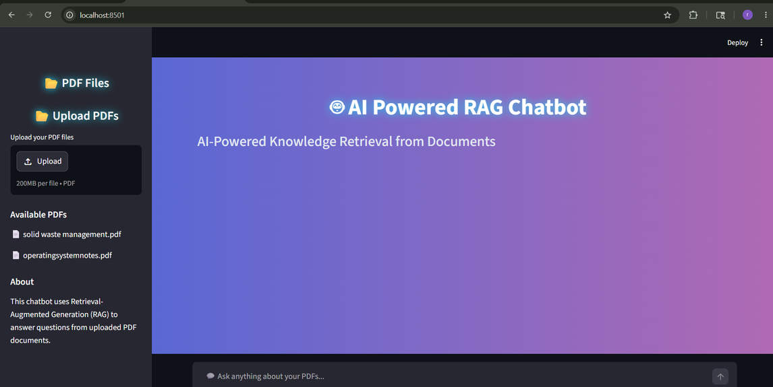
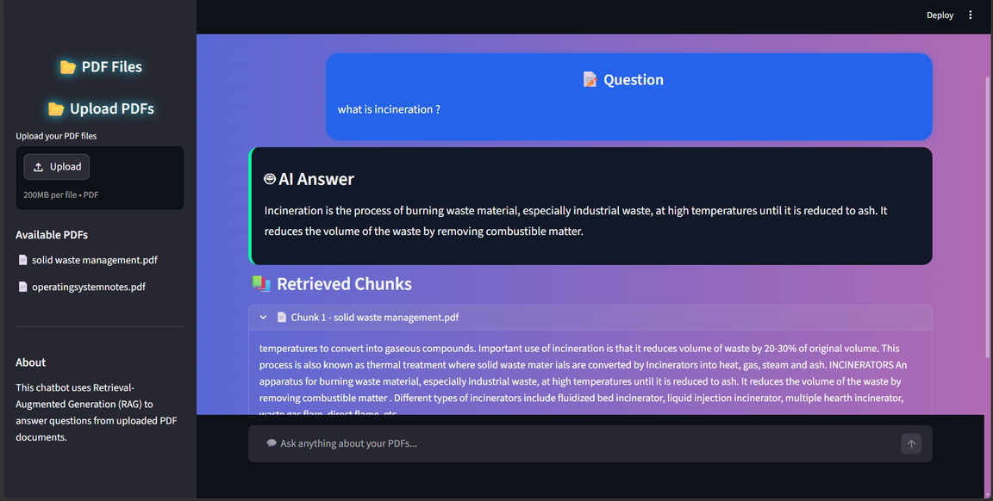
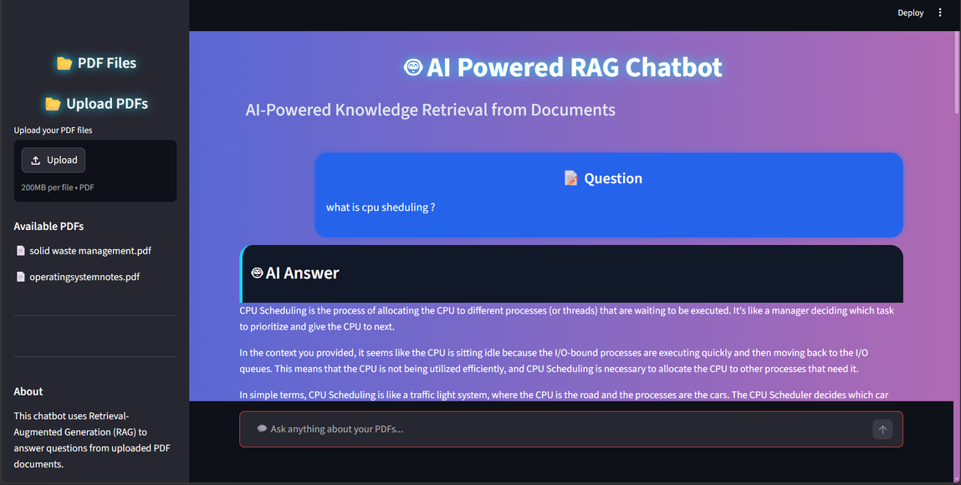
SCREENSHOTS
15

Slide 16
16
CONCLUSION
Successfully developed and enhanced a Retrieval-Augmented Generation (RAG) AI system that enables users to upload PDF documents and receive accurate, context-aware answers through a chatbot interface.
The system was built using Python, Groq API, LangChain, ChromaDB, HuggingFace Embeddings, and Streamlit, combining document retrieval with AI-powered response generation. By implementing features such as semantic search, multiple PDF support, chat history, source chunk display, and persistent storage, the project demonstrated how Generative AI can be used to simplify information retrieval and improve access to knowledge from large documents.

Slide 17
THANK YOU

